Slide 1
Mental Health in Tech
IST 718
Amanda Austin, Daniel Scott, Phillip Song
https://drive.google.com/drive/u/2/folders/0ACeHdrz6mOAfUk9PVA

Slide 2



The Data
OSMI Mental Health in Tech Survey (2017-2021)
  ~120 Survey questions (Multiple Choice & Freeform Text)
  Only not self-employed respondents
  Response Variable: “Score” on a scale from 0 to 15
    “Overall, how much importance does your employer place on mental health?”
    “Overall, how well do you think the tech industry supports employees with mental health issues?”
Google Trends: Mental Health Search Terms (2017-2021)
  Interest Levels
  Search Terms: “Depression,” “Anxiety,” “Mental Health," "Therapy"
Twitter: Scrape Twitter for Search Terms (2017-2021)
https://osmihelp.org/research

Slide 3
How can businesses support employees?
What are companies currently doing to support employee mental health?
How did COVID-19 affect mental health in the tech industry?
What is the sentiment around mental health?

Slide 4
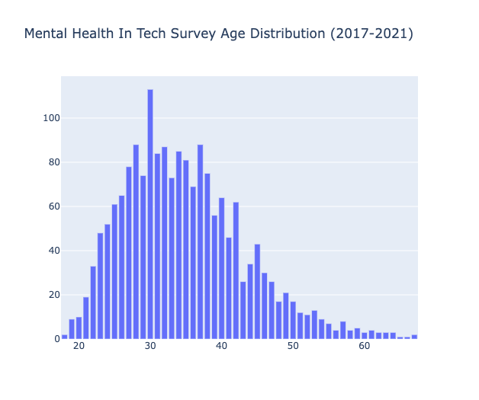
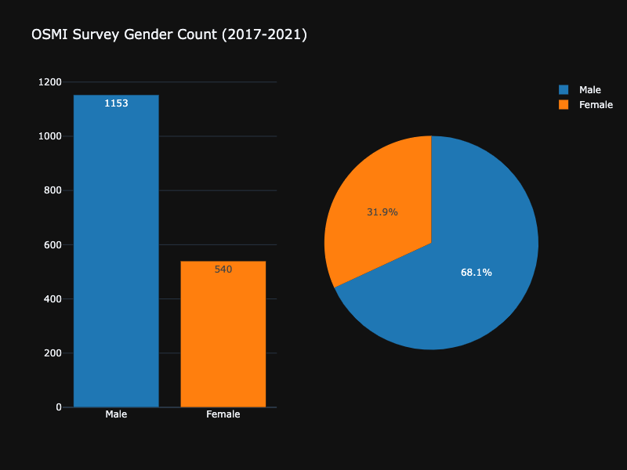
EDA
From update slides (Daniel)
Demographic Data (Phillip)
Spider Chart (Self-employed versus not)
Count
Age

Slide 5
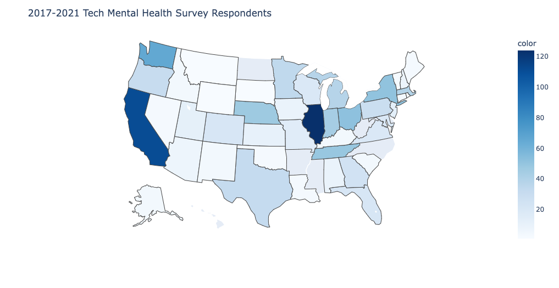
State Distribution
Notes:
Top 4 countries: Illinois 142 California 126 Washington 67 New York 56
US accounted for 67% of total respondents

Slide 6
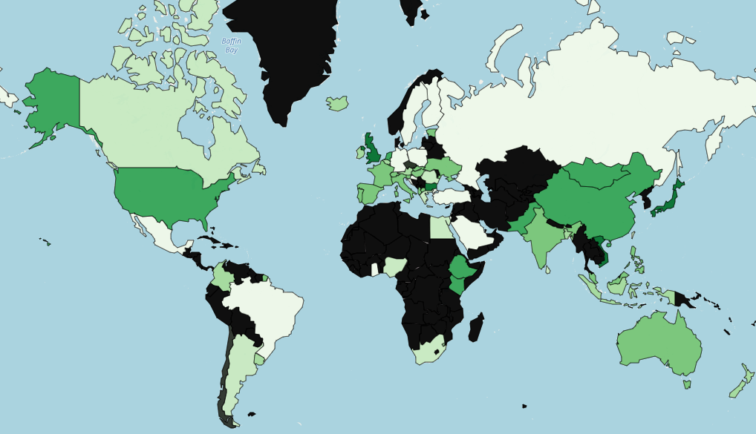

Countries Respondents Work In
Notes:
These are the countries that we got data from
The ones blacked out we didn't have survey data from
Japan, China, and UK had scored higher on our mental health score.

Slide 7

Correlation Matrix: Sample
Notes:
Would u feel comoftable ddiscussing
Does your employer offer resources to learn more about mental health
Has your empoyer formally discussed mental helth

Slide 8
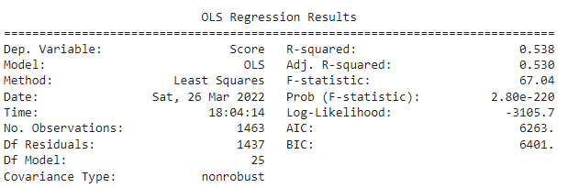
Regression Analysis: Overview
Response Variable: “Score” on a scale from 0 to 15
  “Overall, how much importance does your employer place on mental health?”
  “Overall, how well do you think the tech industry supports employees with mental health issues?”
Six iterations until final model (p-values < 0.1)
Mean Absolute Error = 10.58

Slide 9
Regression Analysis: Results
Contribute Positively to Score:
  Tech company or organization
  Company Policy & Communications:
    Employer formally discusses mental health (wellness campaigns or official communications)
    Employer offers educational resources and options for seeking help
    Employer ensures employee anonymity if/when utilizing mental health or substance abuse treatment resources
    “If a mental health issue prompted you to request a medical leave from work, how easy or difficult would it be to ask for that leave?”
  Culture:
    “Would you feel comfortable discussing a mental health issue with your direct supervisor(s)?”
    “If they knew you suffered from a mental health disorder, how do you think that your team members/co-workers would react?”
    “Have you observed or experienced a supportive or well-handled response to a mental health issue in your current or previous workplace?”
  “Would you bring up your mental health with a potential employer in an interview?”
Contribute Negatively to Score:
  Primary role related to IT/Tech
  Observing or experiencing an unsupportive/poorly handled response to a mental health issue
  Age
  Company Size

Slide 10
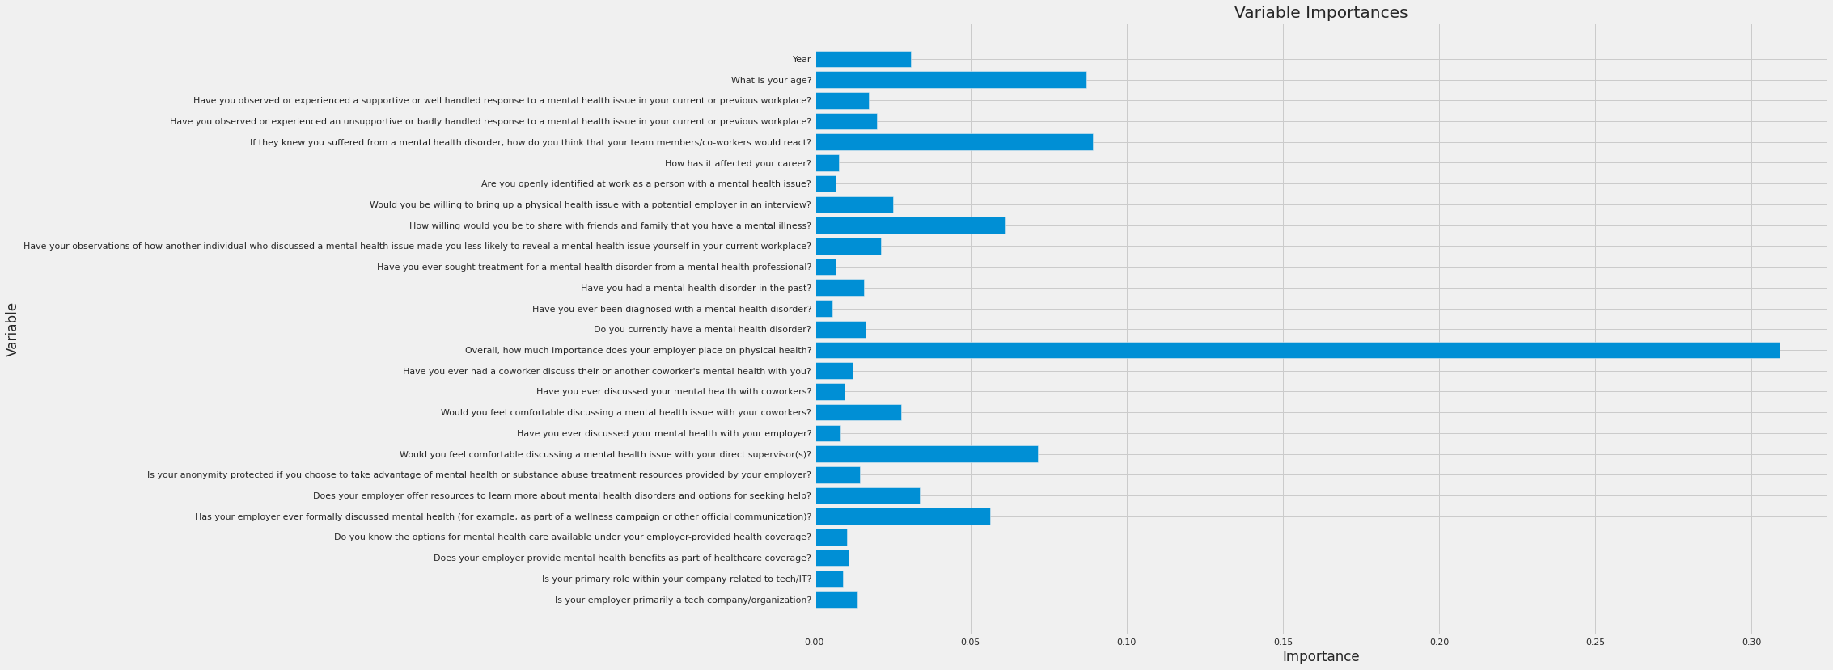

Random Forest

Slide 11
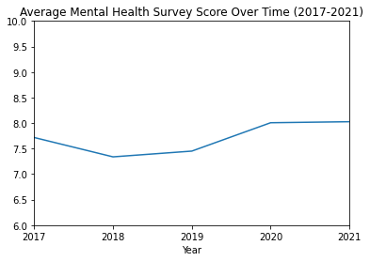

Slide 12
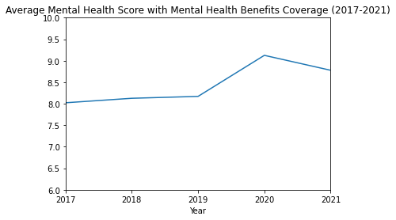
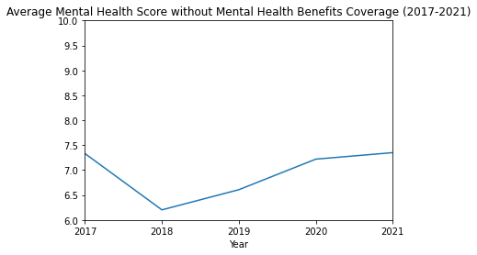

Slide 13
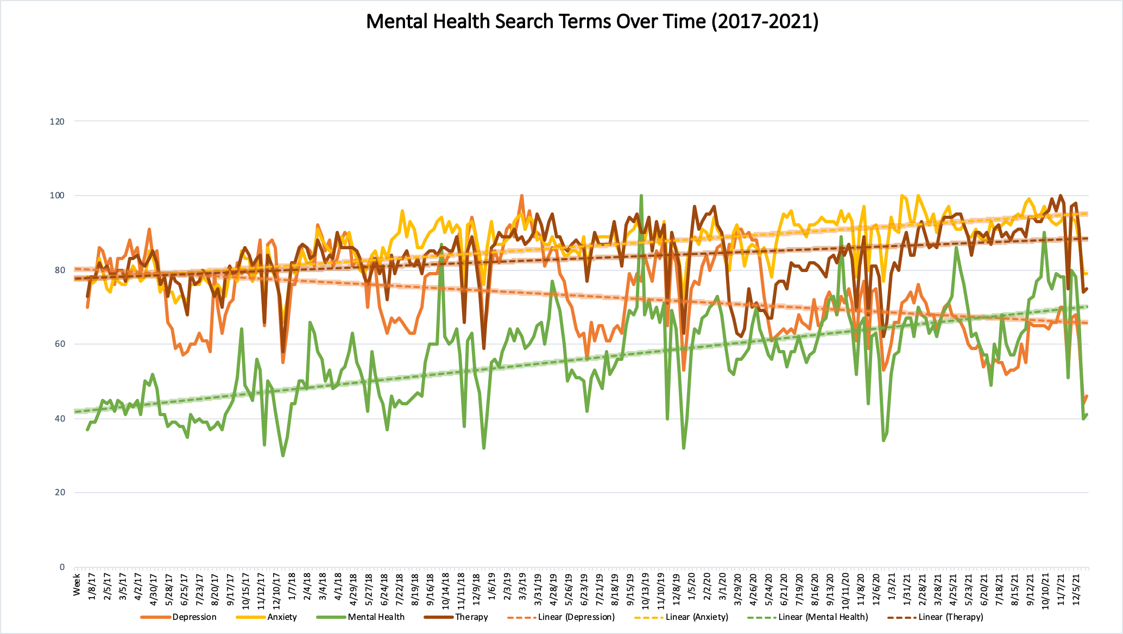
1st covid lockdown

Slide 14
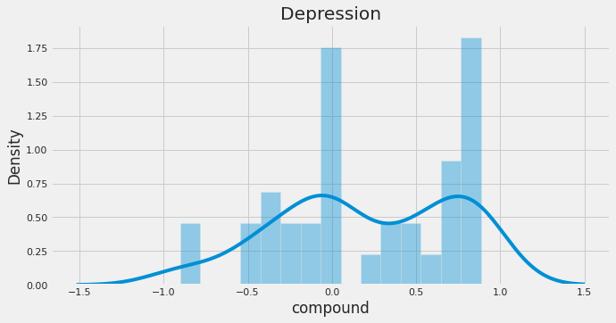
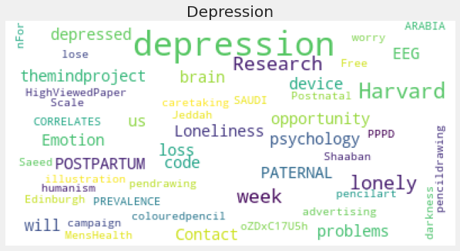
Twitter Data: Depression

Slide 15
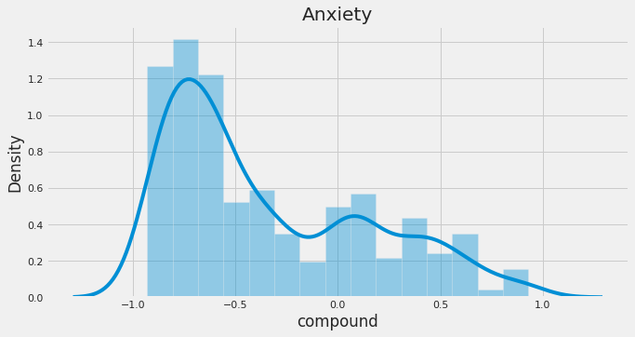
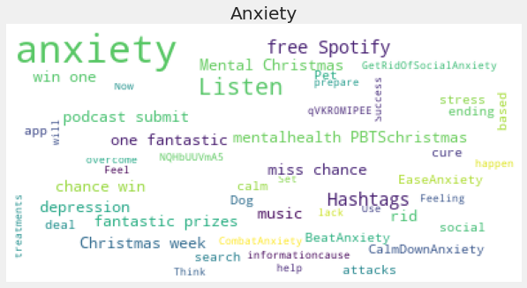
Twitter Data: Anxiety

Slide 16
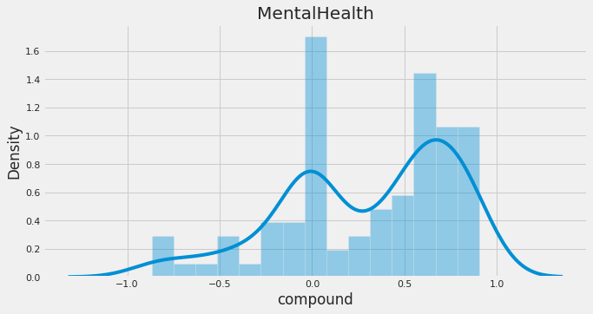
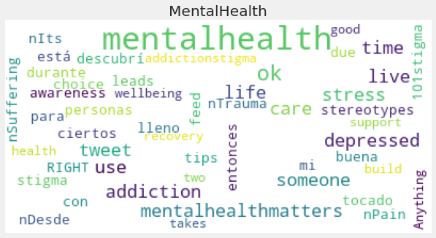
Twitter Data: Mental Health

Slide 17
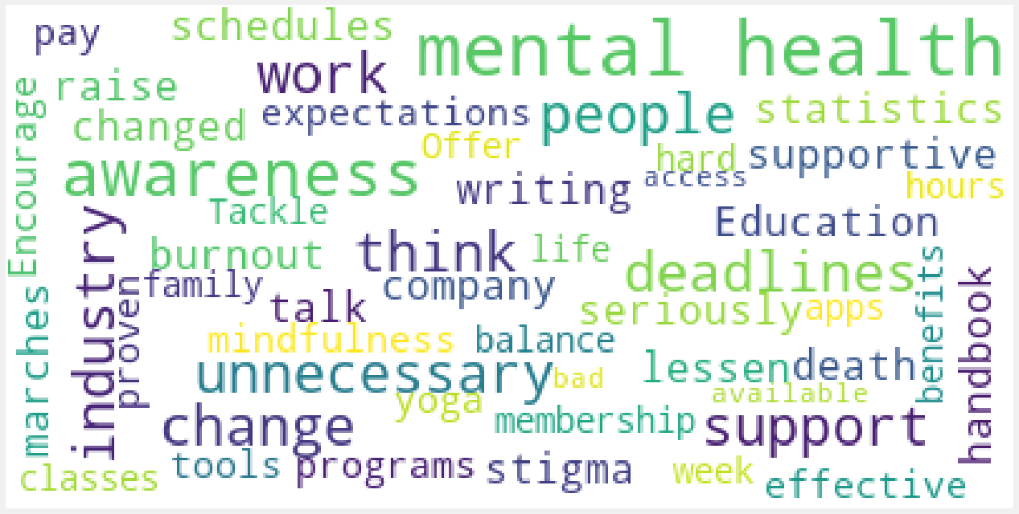
Survey: “Briefly describe what you think the industry as a whole and/or employers could do to improve mental health support for employees.”

Slide 18
Recommendations
Establish policy that does not put barriers in front of employees with mental health issues
Provide mental health care as a part of health insurance, additional resources, and opportunities for further education
Have consistent, clear communication surrounding mental health, especially during stressful times of the year
Foster a workplace culture that does not stigmatize mental health
Continue mental health initiatives brought on by COVID-19 and the lockdown

Slide 19


Slide 20
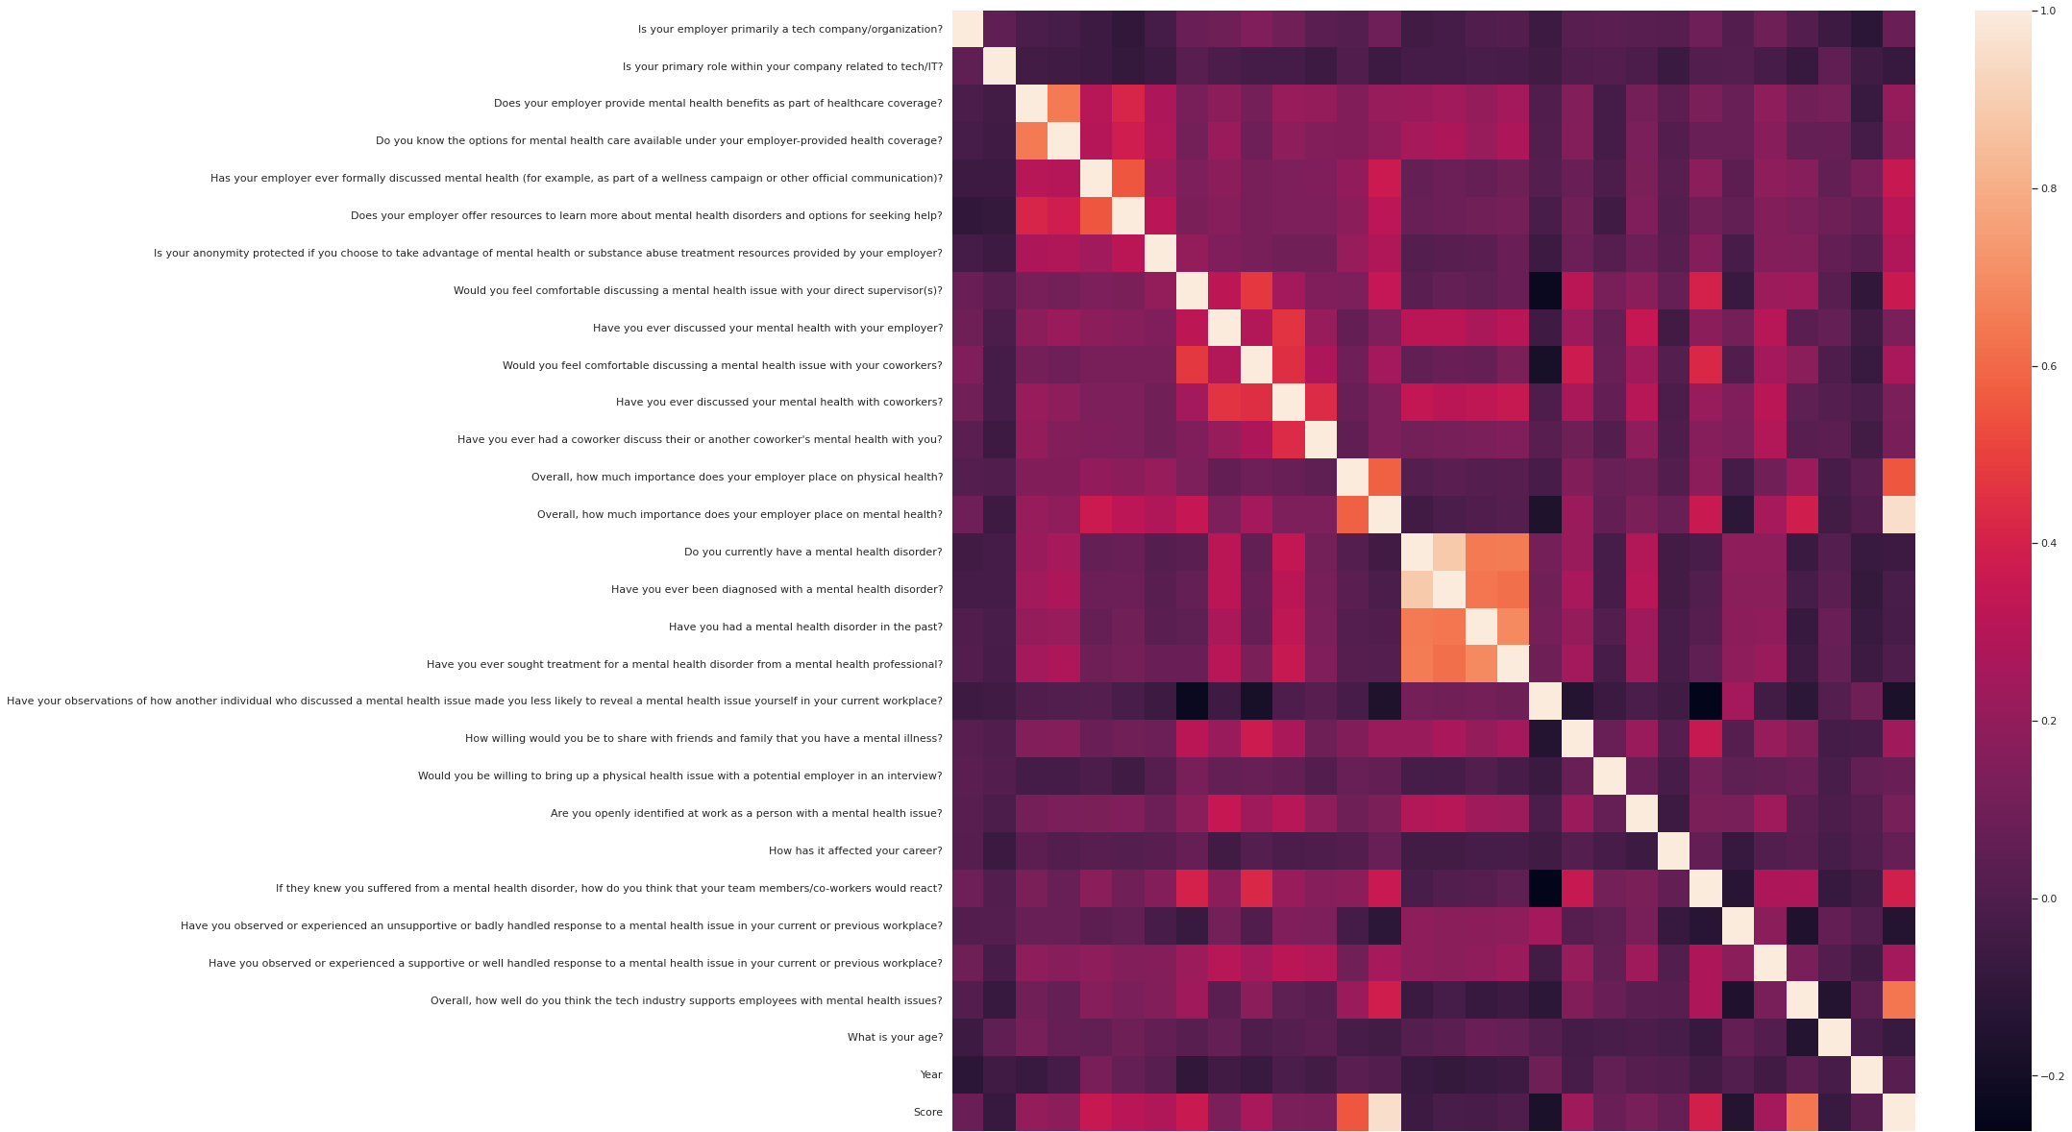
Correlation Matrix: Full

Slide 21
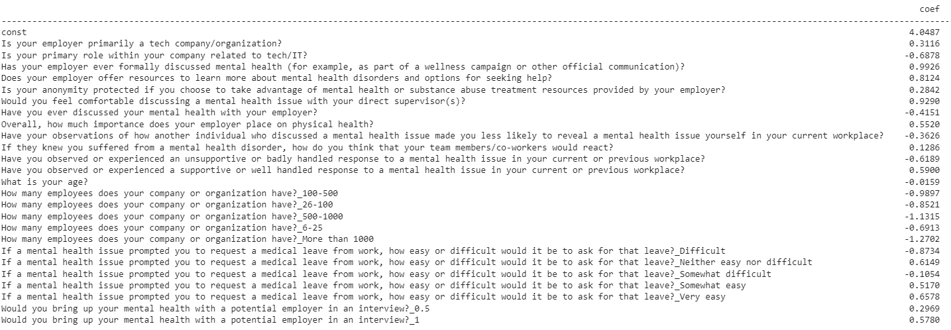
Regression Analysis: Coefficients

Slide 22
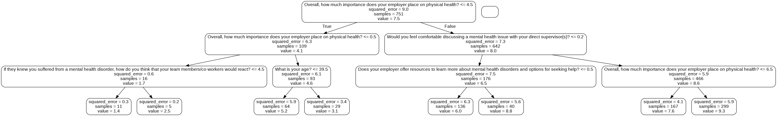
Decision Tree (Small)

